Slide 1
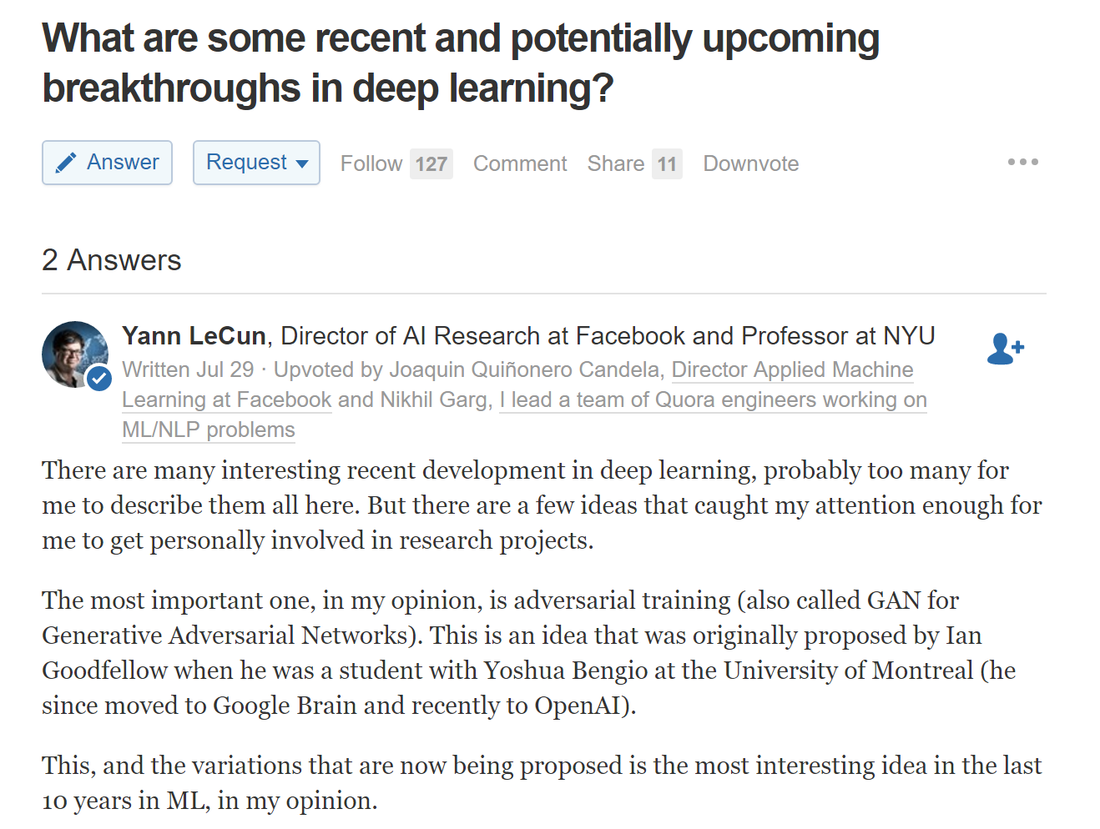
Generative Adversarial Network

Slide 2
Slide credit: Sangdoo Yun @PIL (pil.snu.ac.kr)
Generative Adversarial Network, NIPS 2014
Ian J. Goodfellow, Jean Pouget-Abadie, Mehdi Mirza, Bing Xu, David Warde-Farley, Sherjil Ozair, Aaron Courville, Yoshua Bengio

Slide 3
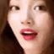

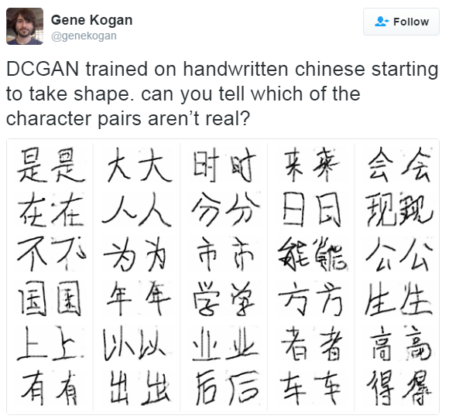



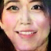


Turing Test

Slide 4
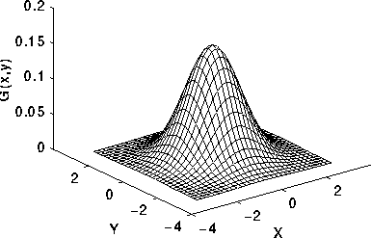
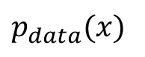
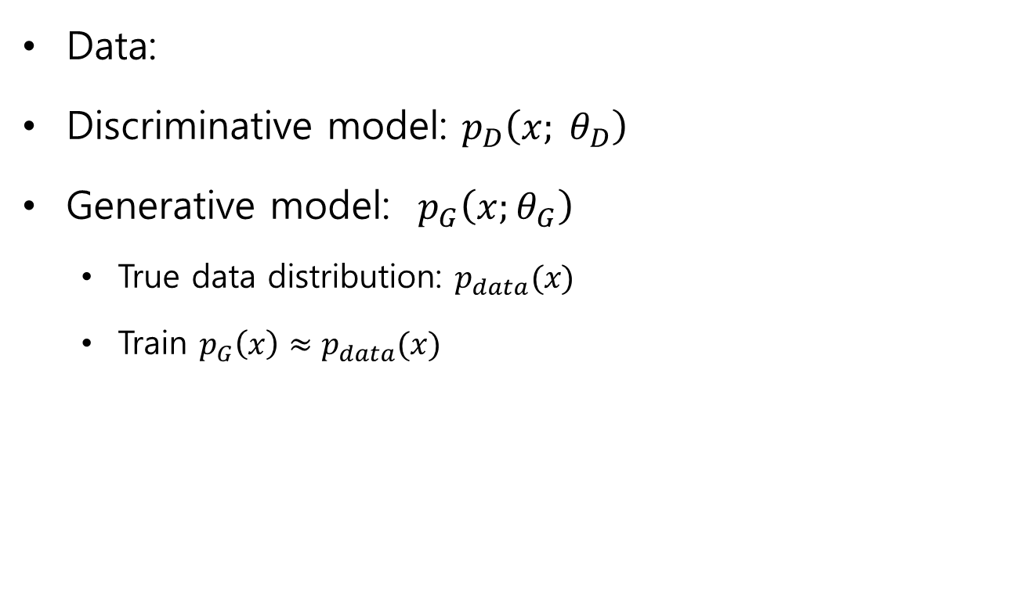
Generative?
…
Data:
Discriminative model: $p_{D}\left(x; θ_{D}\right)$
Generative model: $p_{G}\left(x;θ_{G}\right)$
True data distribution: $p_{data}(x)$
Train $p_{G}\left(x\right)≈p_{data}(x)$
$p_{data}(x)$

Slide 5





Generative Adversarial Network
Counterfeiters vs Police Game
IT’S FAKE MONEY!
IT’S REAL MONEY!

Slide 6
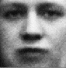

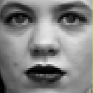

Generative Adversarial Network
Discriminative Model D
Generative Model G
…
…
…
…
…
…
p(z)
…
…
Sample x
Random noise z

Slide 7
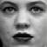

Generative Adversarial Network
Discriminative Model D
Try to classify the sample x
D(x)=0 when x from Data
D(x)=1 when x from G (generator)
1
0
…
…
Differentiable function represented by a multilayer perceptron with parameters
…
…
…
…
sample x
from data
sample x
from G
…
Generative Model G
…
Try to generate sample x
As similar as the real data
…
p(z)
…
random noise z
…

Slide 8
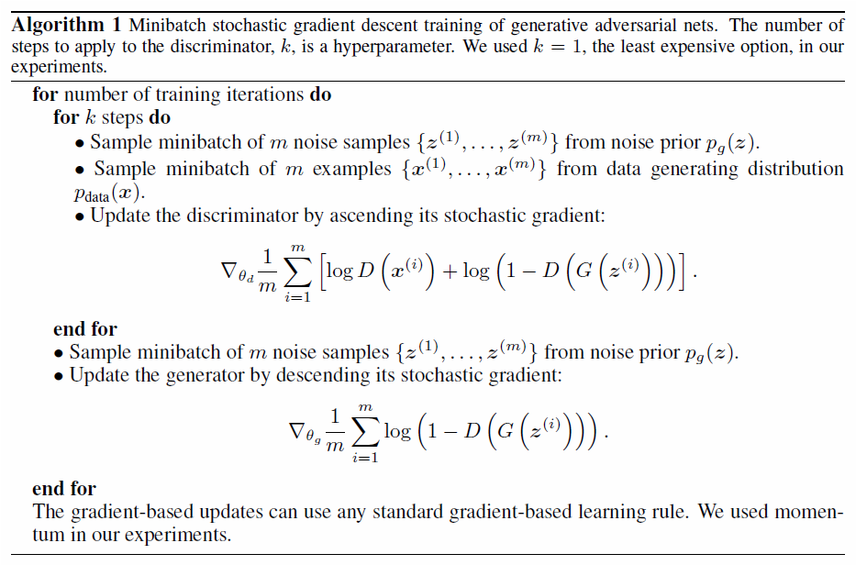


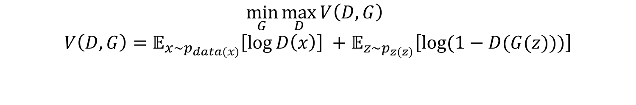
Generative Adversarial Network
$$\min_{G}{\max_{D}{V\left(D,G\right) }}$$
$$V\left(D,G\right)=𝔼_{x\sim p_{data(x)}}\left[\log{D\left(x\right)}\right] +𝔼_{z\sim p_{z(z)}}\left[\log{(1−D(G(z)))}\right]$$
Discriminative Model D
1
0
…
…
…
…
…
…
…
Generative Model G
…
…
…
p(z)
random noise z
…

Slide 9
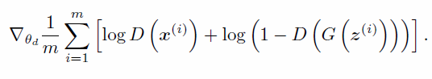
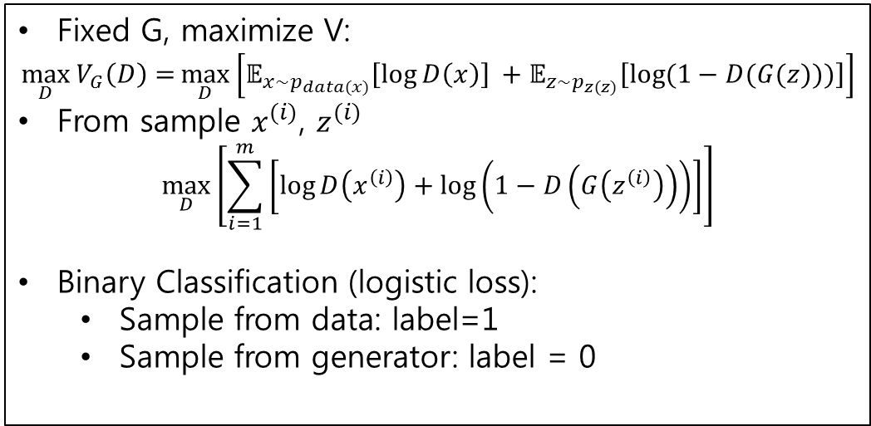
Generative Adversarial Network
$$\min_{G}{\max_{D}{V\left(D,G\right) }}$$
$$V\left(D,G\right)=𝔼_{x\sim p_{data(x)}}\left[\log{D\left(x\right)}\right] +𝔼_{z\sim p_{z(z)}}\left[\log{(1−D(G(z)))}\right]$$
Fixed G, maximize V:
$$\max_{D}{V_{G}\left(D\right)=}\max_{D}\left[𝔼_{x\sim p_{data(x)}}\left[\log{D\left(x\right)}\right] +𝔼_{z\sim p_{z(z)}}\left[\log{(1−D(G(z)))}\right]\right]$$
From sample $x^{(i)}$, $z^{(i)}$
$$\max_{D}\left[\sum_{i=1}^{m}{\left[\log{D\left(x^{\left(i\right)}\right)+\log\left(1−D\left(G\left(z^{\left(i\right)}\right)\right)\right)}\right]}\right]$$
Binary Classification (logistic loss):
Sample from data: label=1
Sample from generator: label = 0
Discriminative Model D
1
0
…
…
…
…
…
…
…
Generative Model G
…
Stochastic Gradient
…
…
p(z)
random noise z
…

Slide 10
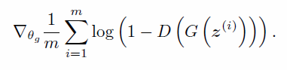
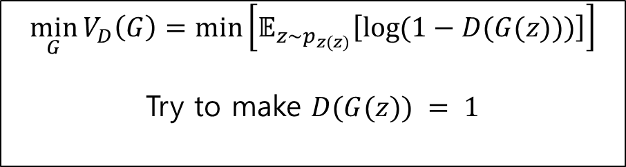
Generative Adversarial Network
$$\min_{G}{\max_{D}{V\left(D,G\right) }}$$
$$V\left(D,G\right)=𝔼_{x\sim p_{data(x)}}\left[\log{D\left(x\right)}\right] +𝔼_{z\sim p_{z(z)}}\left[\log{(1−D(G(z)))}\right]$$
Discriminative Model D
Fixed D, minimize V(G):
1
0
$$\min_{G}{V_{D}\left(G\right)=\min\left[𝔼_{z\sim p_{z(z)}}\left[\log{(1−D(G(z)))}\right]\right]}$$
Try to make $D(G(z)) = 1$
…
…
…
…
…
…
…
Stochastic Gradient
Generative Model G
…
…
…
p(z)
random noise z
…

Slide 11
Generative Adversarial Network
Update D
Update G

Slide 12
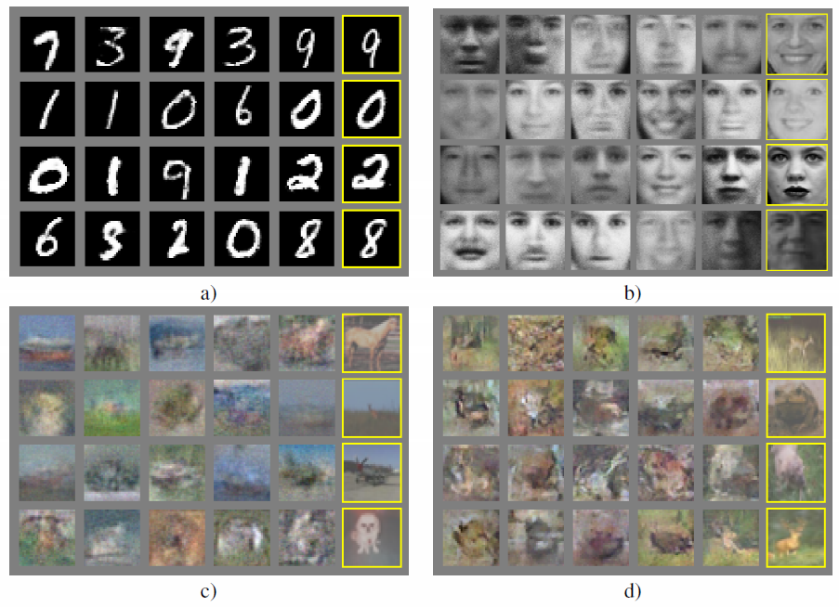
GAN Results
Nearest training example
Generated Samples

Slide 13
Unsupervised Representation Learning with Deep Convolutional Generative Adversarial Network, ICLR 2016.
Slide credit: Sangdoo Yun @PIL (pil.snu.ac.kr)
Alec Radford, Luke Metz and Soumith Chintala

Slide 14
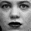

DCGAN
Deep Convolutional Network + GAN
Tricks for stable training
Experimental Analysis
Discriminative Model D
1
0
…
…
…
…
…
…
…
Generative Model G
…
…
…
p(z)
random noise z
…

Slide 15


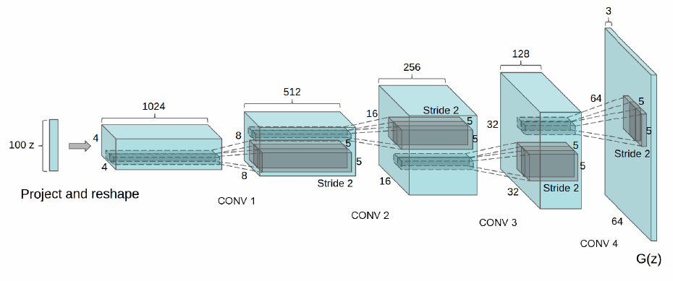
DCGAN
Discriminative Model D
1
0
…
…
…
…
…
…
Replace model’s network to CNN
Example of generator G
(same as D)
…
Generative Model G
…
…
…
p(z)
random noise z
…
z: uniform dist.

Slide 16
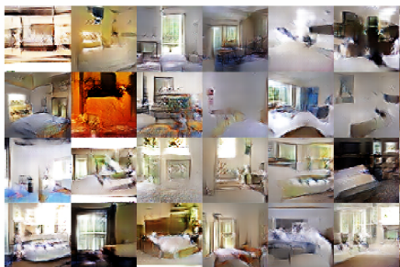
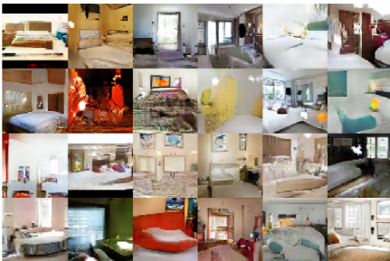
Experiments
LSUN – bedroom dataset
3 million training examples
Epoch #1
Epoch #5

Slide 17
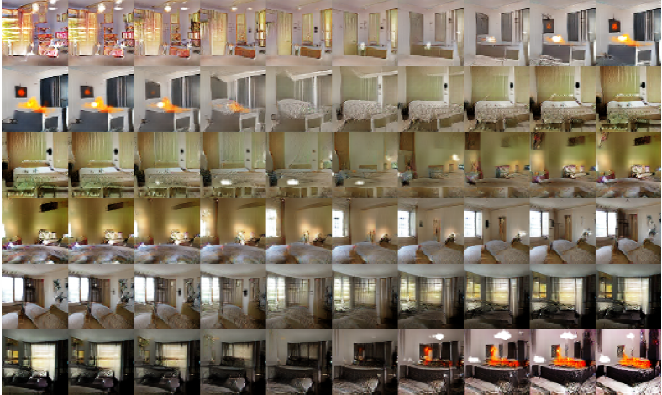
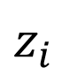
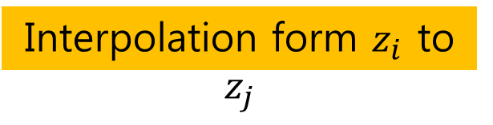
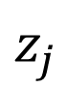
Experiments
Input noise z
Interpolation form $z_{i}$ to $z_{j}$
$$z_{i}$$
$$z_{j}$$

Slide 18
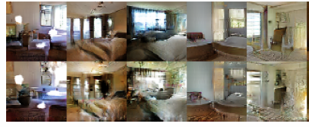
Experiments
Which activations(feature map) in CNN has representation of ‘window’?
At feature activations, assign neuron in the window region is 1, otherwise 0.
Logistic regression to find window-representative feature map.
Window feature map removal

Slide 19
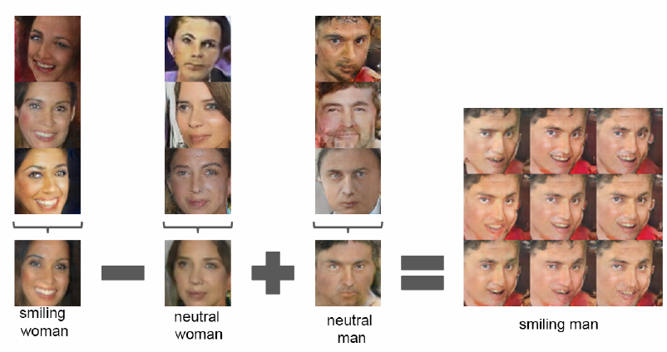
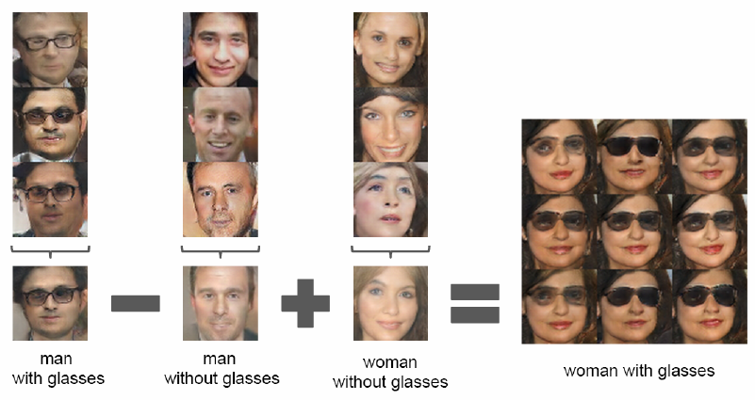
Experiments
Faces – scraped human face image from web
3 million images from 10,000 people.
Vector arithmetic

Slide 20
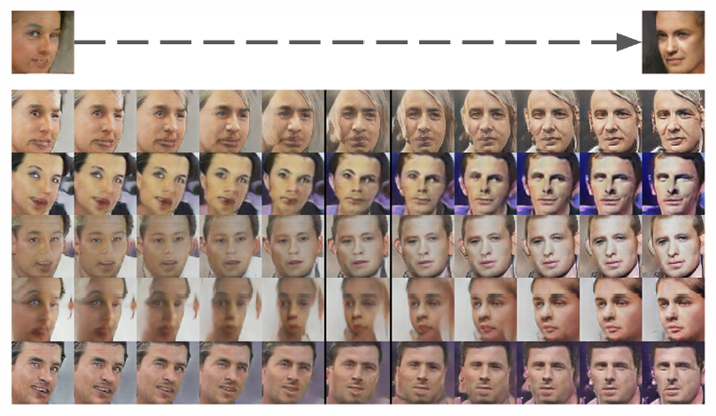
Experiments

Slide 21
Generative Adversarial Text to Image Synthesis, ICML 2016.
Slide credit: Sangdoo Yun @PIL (pil.snu.ac.kr)
Scott Reed*, Zeynep Akata**, Xinchen Yan*, Lajanugen Logeswaran*, Bernt Schiele**, Honglak Lee*
* University of Michigan, Ann Arbor, MI, USA (UMICH.EDU)
** Max Planck Institute for Informatics, Saarbrucken, Germany (MPI-INF.MPG.DE)

Slide 22
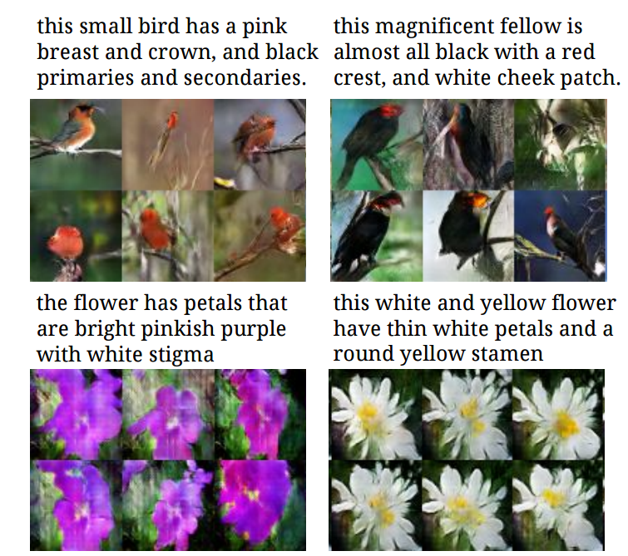
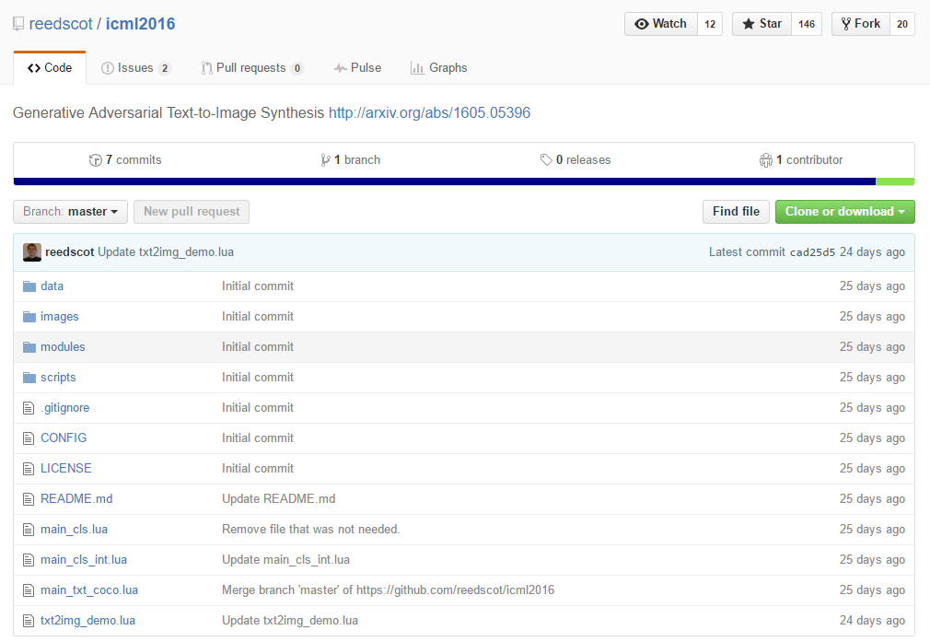
Generative Adversarial Text to Image Synthesis

Slide 23
Generative model
What I cannot create, I do not understand —Richard Feynman
Generating images
Image data (e.g. ImageNet): samples from the true data distribution.
Generative model (e.g. deep neural network): outputs images, which means samples from the model.

Slide 24
Review of GAN
Counterfeiters vs Police Game
IT’S FAKE MONEY!
IT’S REAL MONEY!

Slide 25
Review of GAN
Discriminator Model D
Generator Model G
…
…
…
…
…
…
p(z)
…
…
Sample x
Random noise z

Slide 26
Review of GAN
Discriminator Model D
Try to classify the sample x
D(x)=0 when x from Data
D(x)=1 when x from G (generator)
1
0
…
…
Differentiable function represented by a multilayer perceptron with parameters
…
…
…
…
sample x
from data
sample x
from G
…
Generator Model G
…
Try to generate sample x
As similar as the real data
…
p(z)
…
random noise z
…

Slide 27
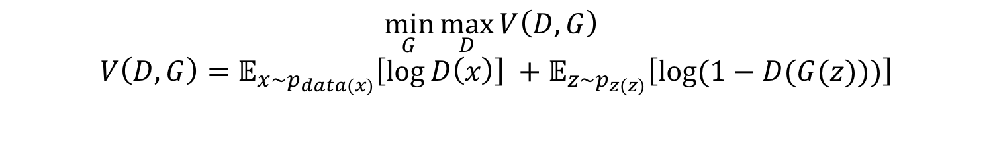
Generative Adversarial Network
$$\min_{G}{\max_{D}{V\left(D,G\right) }}$$
$$V\left(D,G\right)=𝔼_{x\sim p_{data(x)}}\left[\log{D\left(x\right)}\right] +𝔼_{z\sim p_{z(z)}}\left[\log{(1−D(G(z)))}\right]$$
Discriminator Model D
1
0
…
…
…
…
…
…
…
Generator Model G
…
…
…
p(z)
random noise z
…

Slide 28
Review of DCGAN
Discriminative Model D
1
0
…
…
…
…
…
…
Replace model’s network to CNN
Example of generator G
(same as D)
…
Generative Model G
…
…
…
p(z)
random noise z
…
z: uniform dist.

Slide 29
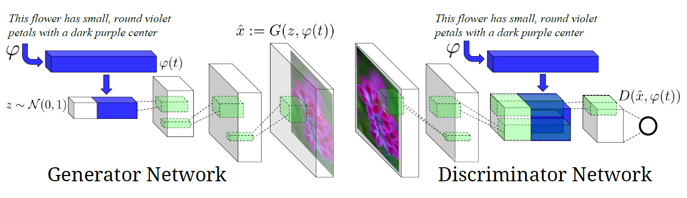
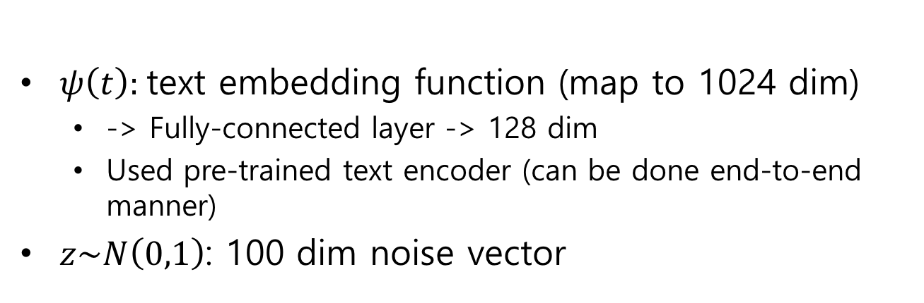
GAN – text to image synthesis
$ψ\left(t\right):$text embedding function (map to 1024 dim)
-> Fully-connected layer -> 128 dim
Used pre-trained text encoder (can be done end-to-end manner)
$z\sim N\left(0,1\right)$: 100 dim noise vector
Text-Conditional GAN

Slide 30
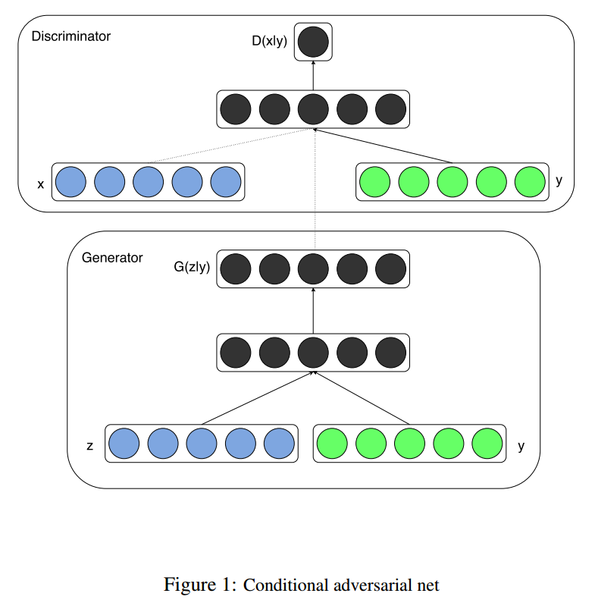
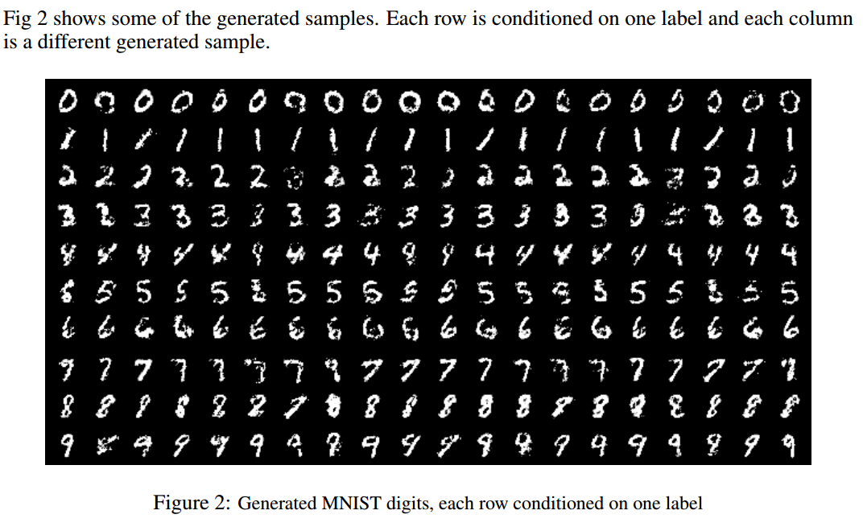
Conditional GAN
Mirza, Mehdi, and Simon Osindero. "Conditional generative adversarial nets."arXiv preprint arXiv:1411.1784 (2014).

Slide 31
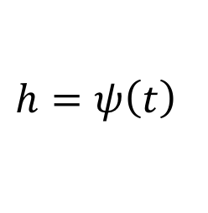
Text-conditional GAN (naïve)
128 dim
4*4*16
Real image & matched text
Fake image & arbitrary text
$$h=ψ\left(t\right)$$
$$\min_{G}{\max_{D}{E_{x\sim p_{data}}\left[\log\left(D\left(x,h\right)\right)\right]+E_{z\sim p_{z}}\left[\log\left(1−D\left(G\left(z,\hat{h}\right),\hat{h}\right)\right)\right]}}$$

Slide 32
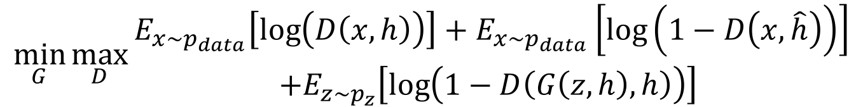
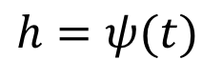
Matching-aware discriminator
128 dim
4*4*16
Real image & matched text
Real image & mismatched text
$$h=ψ(t)$$
$$\min_{G}{\max_{D}{\begin{aligned}E_{x\sim p_{data}}\left[\log\left(D\left(x,h\right)\right)\right]+E_{x\sim p_{data}}\left[\log\left(1−D\left(x, \hat{h}\right)\right)\right] \\ +E_{z\sim p_{z}}\left[\log\left(1−D\left(G\left(z,h\right),h\right)\right)\right] \end{aligned}}}$$
Fake image & matched text

Slide 33
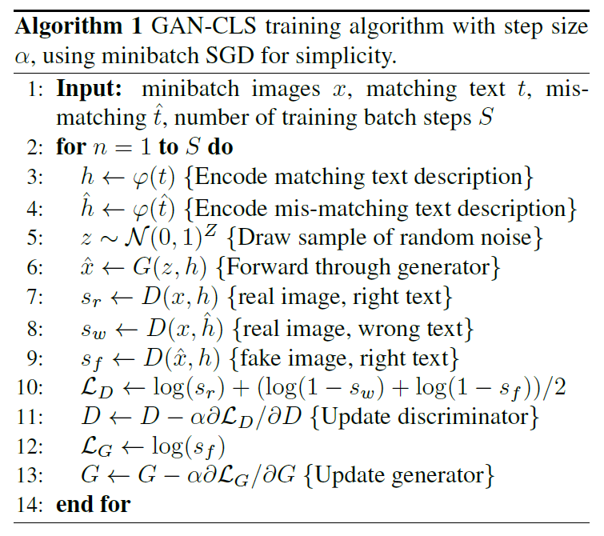
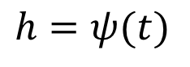
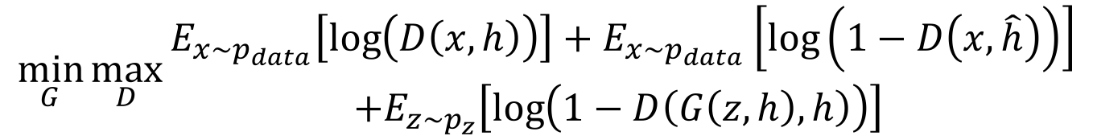
Matching-aware Discriminator
Real image & matched text
Real image & mismatched text
$$h=ψ(t)$$
$$\min_{G}{\max_{D}{\begin{aligned}E_{x\sim p_{data}}\left[\log\left(D\left(x,h\right)\right)\right]+E_{x\sim p_{data}}\left[\log\left(1−D\left(x, \hat{h}\right)\right)\right] \\ +E_{z\sim p_{z}}\left[\log\left(1−D\left(G\left(z,h\right),h\right)\right)\right] \end{aligned}}}$$
Fake image & matched text

Slide 34
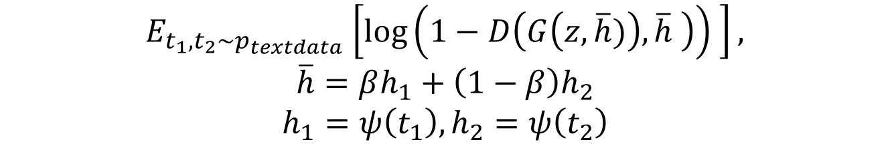
Learning with Manifold Interpolation
Real image & matched text
Real image & mis-matched text
$$h=ψ(t)$$
$$\min_{G}{\max_{D}{\begin{aligned}E_{x\sim p_{data}}\left[\log\left(D\left(x,h\right)\right)\right]+E_{x\sim p_{data}}\left[\log\left(1−D\left(x, \hat{h}\right)\right)\right] \\ +E_{z\sim p_{z}}\left[\log\left(1−D\left(G\left(z,h\right),h\right)\right)\right] \end{aligned}}}$$
Fake image & matched text
Additional term to generator to minimize:
$E_{t_{1},t_{2}\sim p_{textdata}}\left[\log\left(1−D\left(G\left(z,\overline{h})\right),\overline{h} \right)\right) \right],$
$$\overline{h}=βh_{1}+\left(1−β\right)h_{2}$$
$$h_{1}=ψ\left(t_{1}\right), h_{2}=ψ\left(t_{2}\right)$$

Slide 35
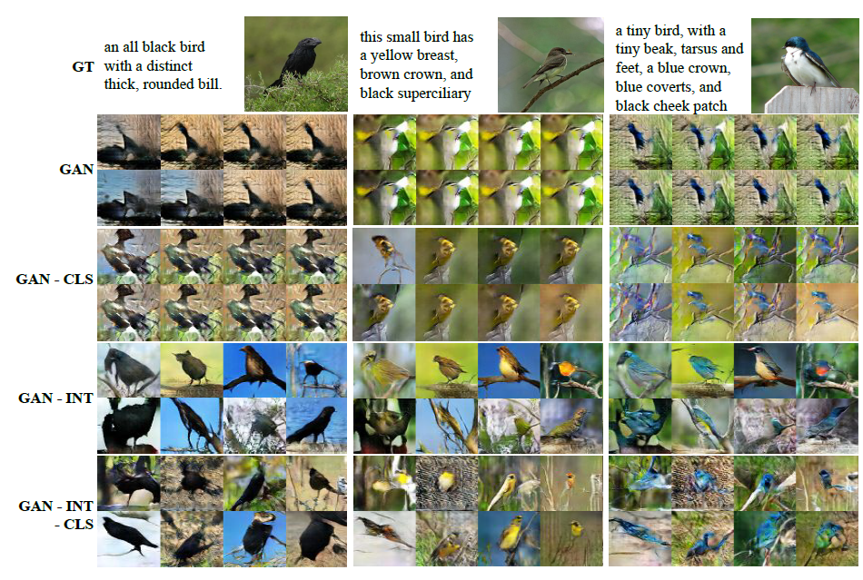
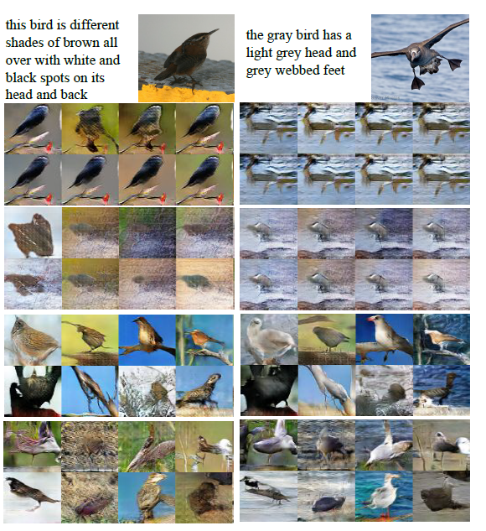
Experiments

Slide 36
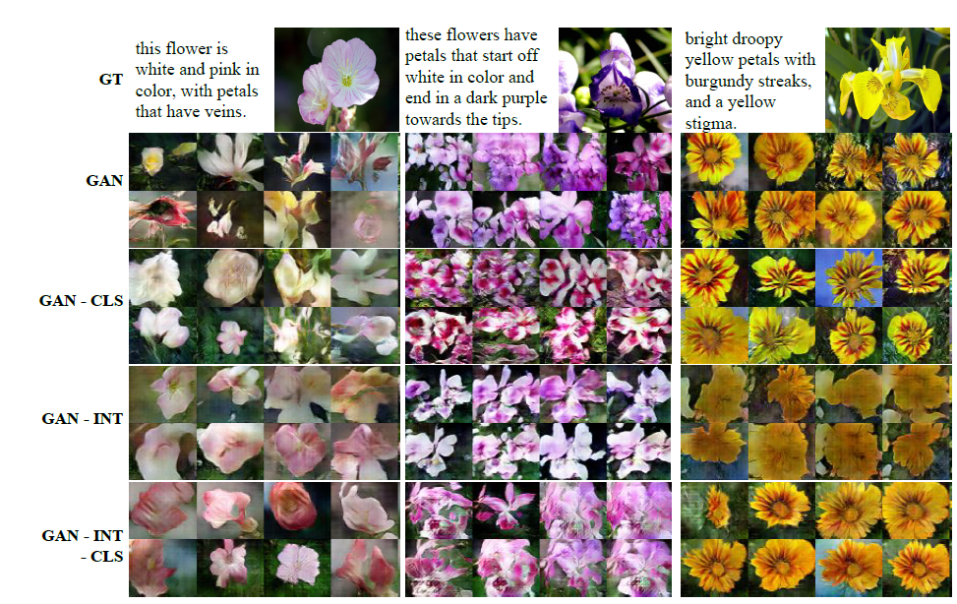
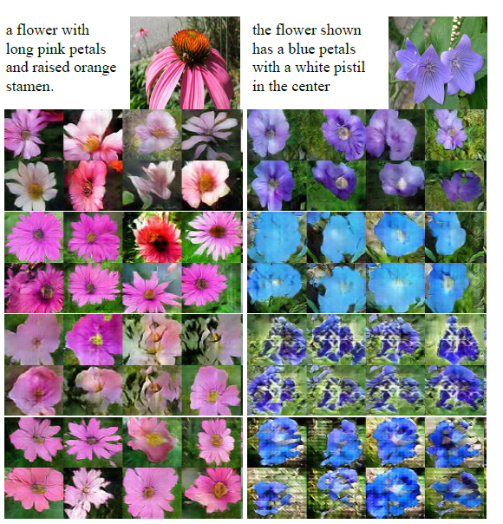
Experiments

Slide 37
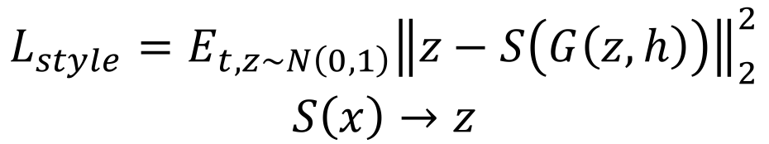
Style Transfer
128 dim
4*4*16
$$L_{style}=E_{t,z\sim N\left(0,1\right)}{\left\|z−S\left(G\left(z,h\right)\right)\right\|}_{2}^{2}$$
$$S\left(x\right)→z$$
Finding an inverse mapping from an image to vector

Slide 38
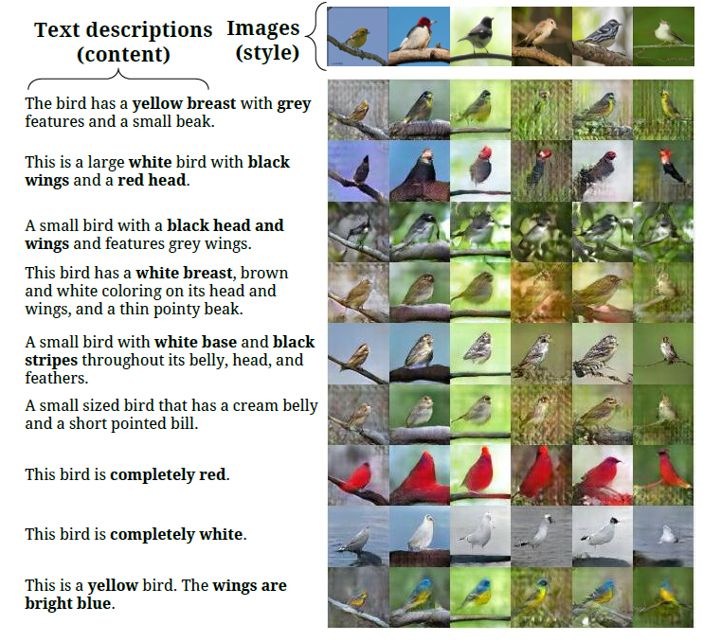
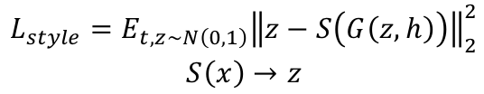

Style Transfer
$$L_{style}=E_{t,z\sim N\left(0,1\right)}{\left\|z−S\left(G\left(z,h\right)\right)\right\|}_{2}^{2}$$
$$S\left(x\right)→z$$
Input image: $x$
Style: $z = S(x)$
Generated image: $G(z,h)$
Image
Style vector
Style transferred image
Text description

Slide 39

Sentence Interpolation

Slide 40

Pixel Level Domain Transfer, ECCV 2016.

Slide 41

Domain transfer

Slide 42

Whole architecture
Converter: deconvnet
Discriminator: Real vs. Fake
Discriminator : Associated or not

Slide 43

Dataset

Slide 44

Results

Slide 45

Results – varying input conditions

Slide 46

Results – inverse setting

Slide 47

Image to Image Translation
Image-to-Image Translation with Conditional Adversarial Networks

Slide 48


Image to Image Translation
+ L1 loss function
Low-freq correctness
+ PatchGAN
High-freq correctness

Slide 49




Image to Image Translation

Slide 50




Image to Image Translation

Slide 51


Plug & Play Generative Networks

Slide 52

Plug & Play Generative Networks

Slide 53








Noiseless joint PPGN-h
Update Rule for a feature vector h
Training G
Training D

Slide 54

Noiseless joint PPGN-h
Encoder network is pre-trained.
G and D are trained with standard GAN learning technique.
G is not directly used to generate image, but used as a guiding function combined with DAE.

Slide 55

PPGN results

Slide 56

PPGN results

Slide 57
Thank you

